Slide 1
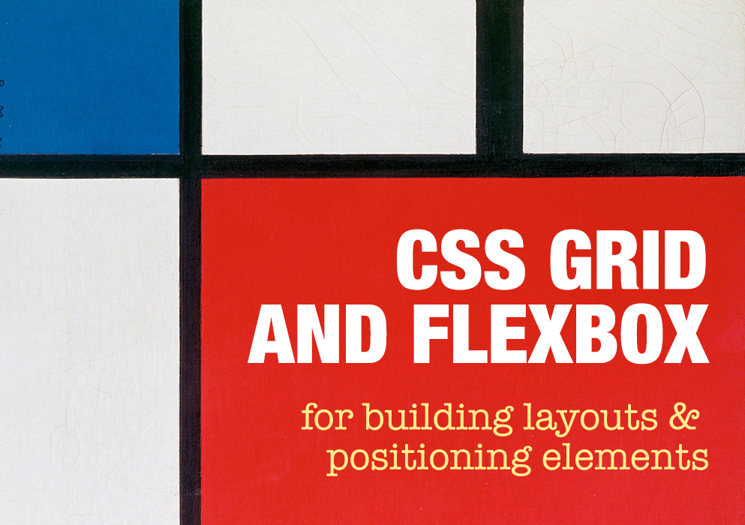

Slide 2
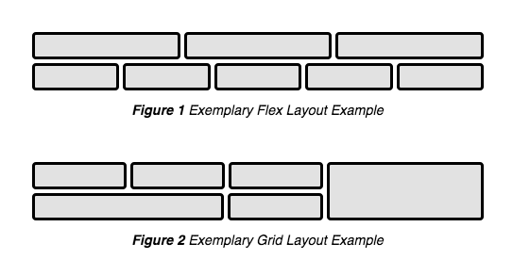
What is CSS Grid and Flexbox?
Grid is a CSS specification for building entire layouts
Flexbox is a CSS specification for positioning elements along one axis, rows or columns (1 dimension)
Notes:
CSS grid:
- using rows and columns (2 dimensions)
Fixed or flexible – regions can be defined using multiple units of measurement such as pixels, ems, or frs (fraction unit).
(Frs make use of available space)
- Can specify your layout to grow based on the content needs
There are both explicit rows and implicit rows
Flexbox:
- one-dimensional specification that positions items in a row or a column
- When content wraps onto a new row, the row itself is a new flex container, and available space for that row is reset
Example: https://codepen.io/rachelandrew/pen/YqqdXL With wrapping, the items on the second row grow or shrink to take up available space, with CSS grid, you can set a more specific placement of where each item will appear throughout the grid on axis.

Slide 3
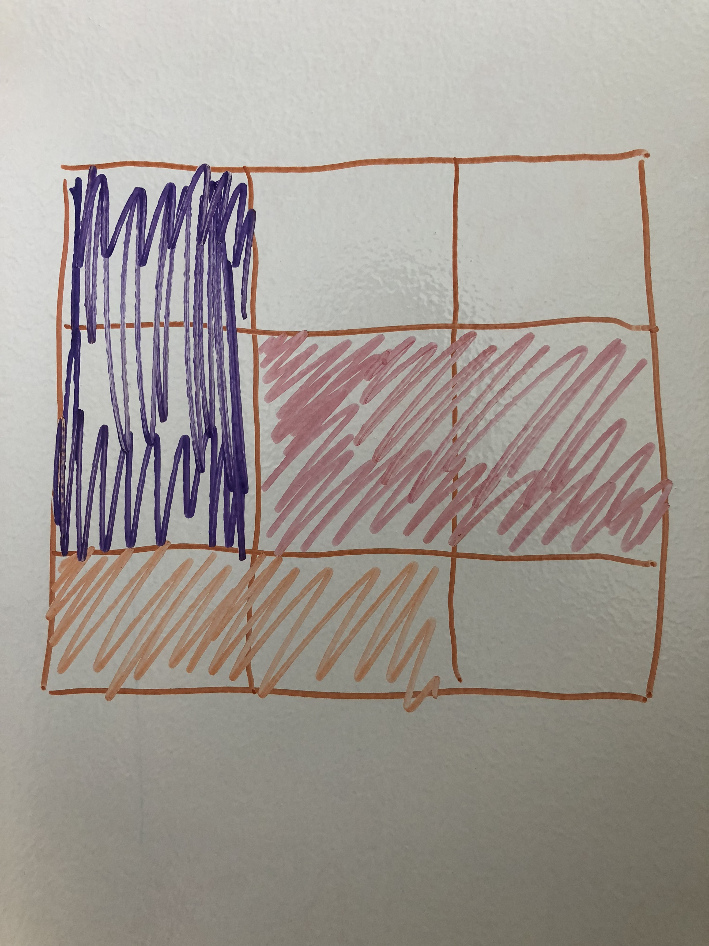
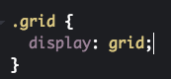
Why use Grid?
Flexible design
More control over precise positioning of elements and regions across device and screen widths – including the ordering
Simpler to code, fewer lines needed, easier to read
Just requires a container and direct child elements
Can be nested
Notes:
What you gain with Grid is a very flexible design, more control over positioning your regions in different device and screen widths: not only can you decide if multi-column layouts reduce to a single column layout as screen sizes decrease, but also you can control the ordering and precise placement of the cells and how much of the grid they span
Layouts can be created with fewer lines of code – it’s very easy to implement, very easy to read, you need a container and direct child elements
and it can be nested - put grids inside grids to avoid creating a flat DOM.

Slide 4
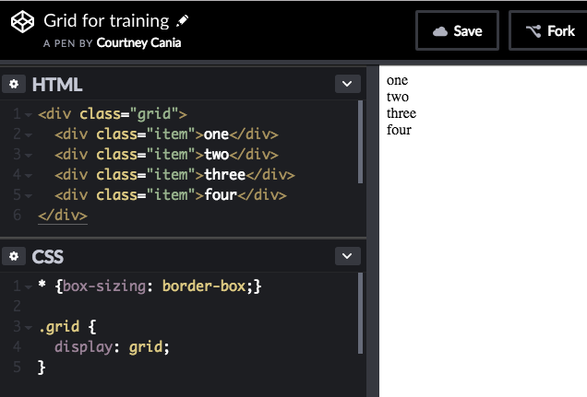
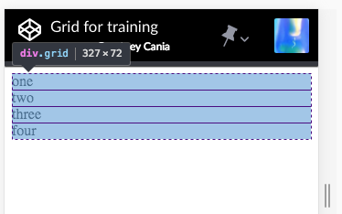
Basic grid in its simplest form, before adding properties for columns and rows
Notes:
Basic grid

Slide 5
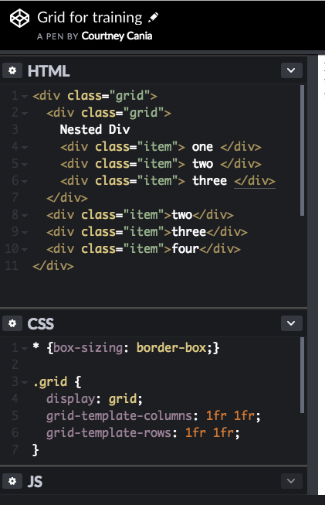
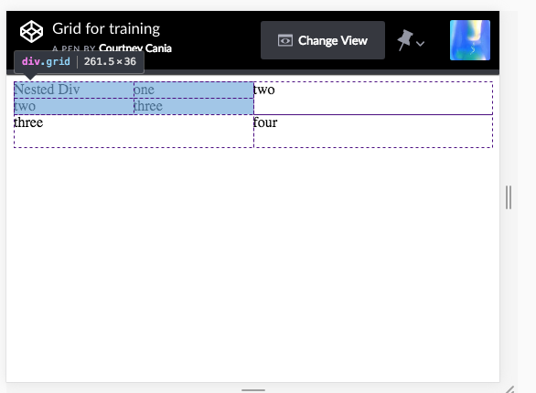
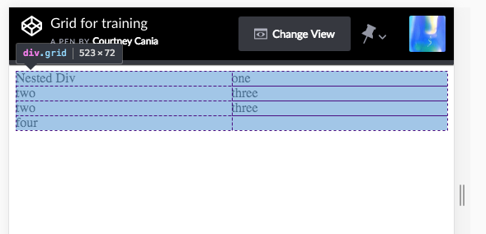
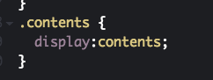
Notes:
Nested grid - You can build grids within your grids
- In reality you would want separate classes to describe columns and rows for each nested grid, if a different inner layout is desired, for example, if you wanted one column or just one row in the nested div.
Display: contents – a css property that when applied, makes the container disappear. So you don’t need to write a flat dom architecture, since grid only works on its direct dependents, but display: contents makes children of children items adhere to the grid, so you can write semantic HTML and a nested dom structure as needed.

Slide 6
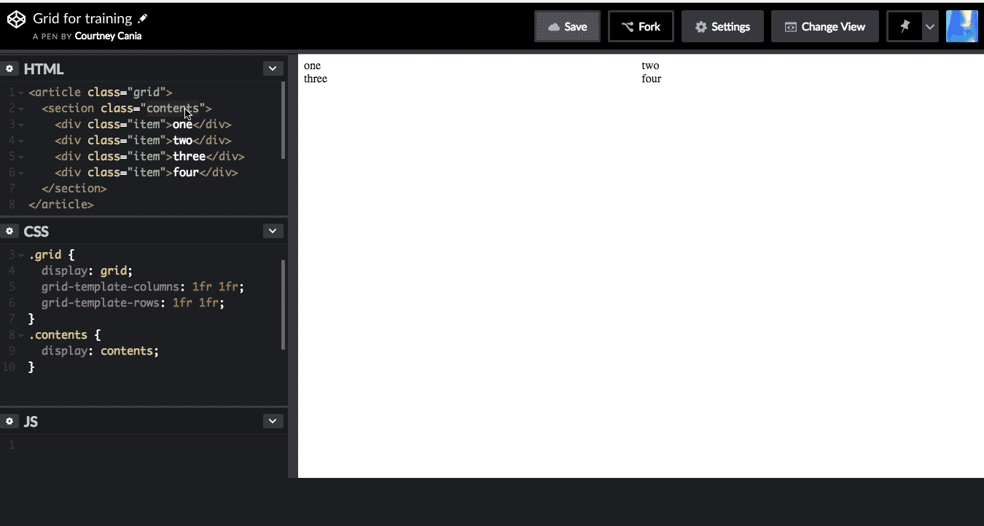
Semantic HTML – Display Contents
Notes:
Example of semantic html structure where display contents has been applied to the section element. Display: contents negates the section as a container element and the inner divs are moved up a level.
Read more about this here https://css-tricks.com/get-ready-for-display-contents/
There are some caveats to using display:contents though, borders and background styles that are set are not inherited to past the child elements – you could get around this by adding a class to all your elements with this styling, or you could use something different like Flexbox

Slide 7
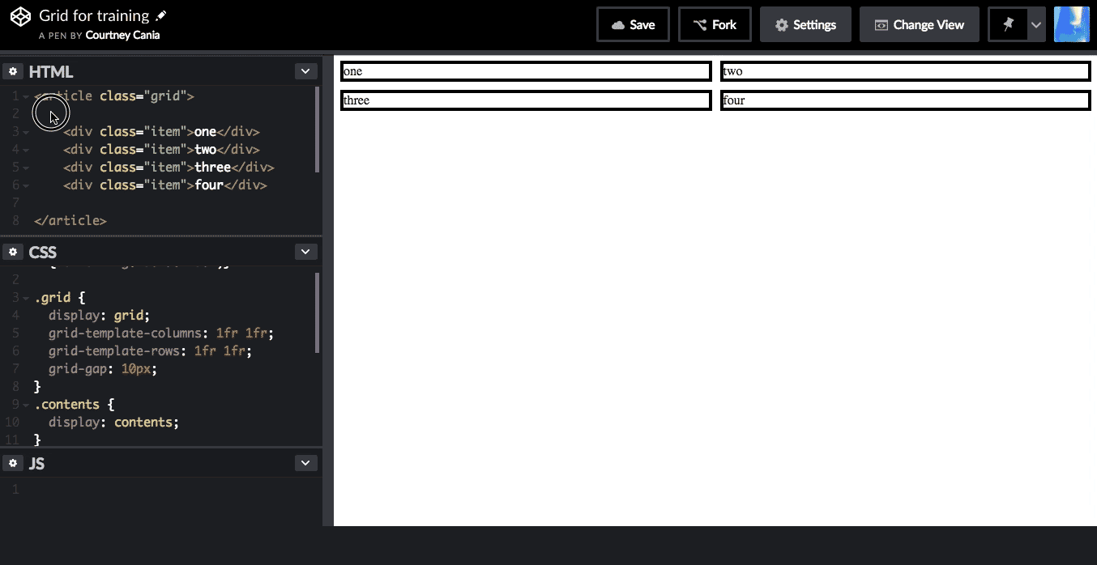
Display: contents – does not produce _real_ children
Notes:
More reading about subgrid https://rachelandrew.co.uk/archives/2017/07/20/why-display-contents-is-not-css-grid-layout-subgrid/
https://www.smashingmagazine.com/2018/07/css-grid-2/

Slide 8
When should I use Grid? When should I use flexbox?
Use grid for major layouts
Grid is layout-first, flexbox is content-first
Use Flexbox when you need to position items in a row or column and it doesn’t matter where the items wrap / line up onto the next line
Ex: Codepen on this page
Ex: navigation – just want your items to float across in a line
Use Grid when you want to control the columns AND the rows that the elements will take up
Use Grid when you want to control the alignment by row and column
Notes:
More on how to choose https://rachelandrew.co.uk/archives/2016/03/30/should-i-use-grid-or-flexbox/
https://medium.com/youstart-labs/beginners-guide-to-choose-between-css-grid-and-flexbox-783005dd2412
When flex items wrap onto the next row, the row is a container itself and the space distribution resets.
“In the image, you can see that two items have wrapped onto a new line. These items are sharing the available space and not lining up underneath the items above. This is because when you wrap flex items, each new row (or column when working by column) becomes a new flex container. Space distribution happens across the row.
A common question then is how to make those items line up. This is where you want a two-dimensional layout method: You want to control the alignment by row and column, and this is where grid comes in.”

Slide 9
What’s the State of Support?
Td;dr Grid is mostly supported as of March 2017, and Flexbox widely-supported with the exception of some issues IE11.
Grid:
IE11: partial support with prefix
Edge: Version 12+ partial with prefix, full in Version 16 released Oct 2017
Samsung Internet: 6.2+, released Oct 2018
Full Support in browser versions released in March 2017:
Firefox: Version 52+
Chrome: Version 57+
Safari: Version 10.1+
Safari iOS: 10.3+
Full Support in browser versions released May 2018
Chrome Android: 67+
No Support: Opera Mini
Support resources
https://github.com/rachelandrew/gridbugs
Flexbox caniuse.com https://caniuse.com/#feat=flexbox
Grid caniuse.com https://caniuse.com/#feat=css-grid

Slide 10
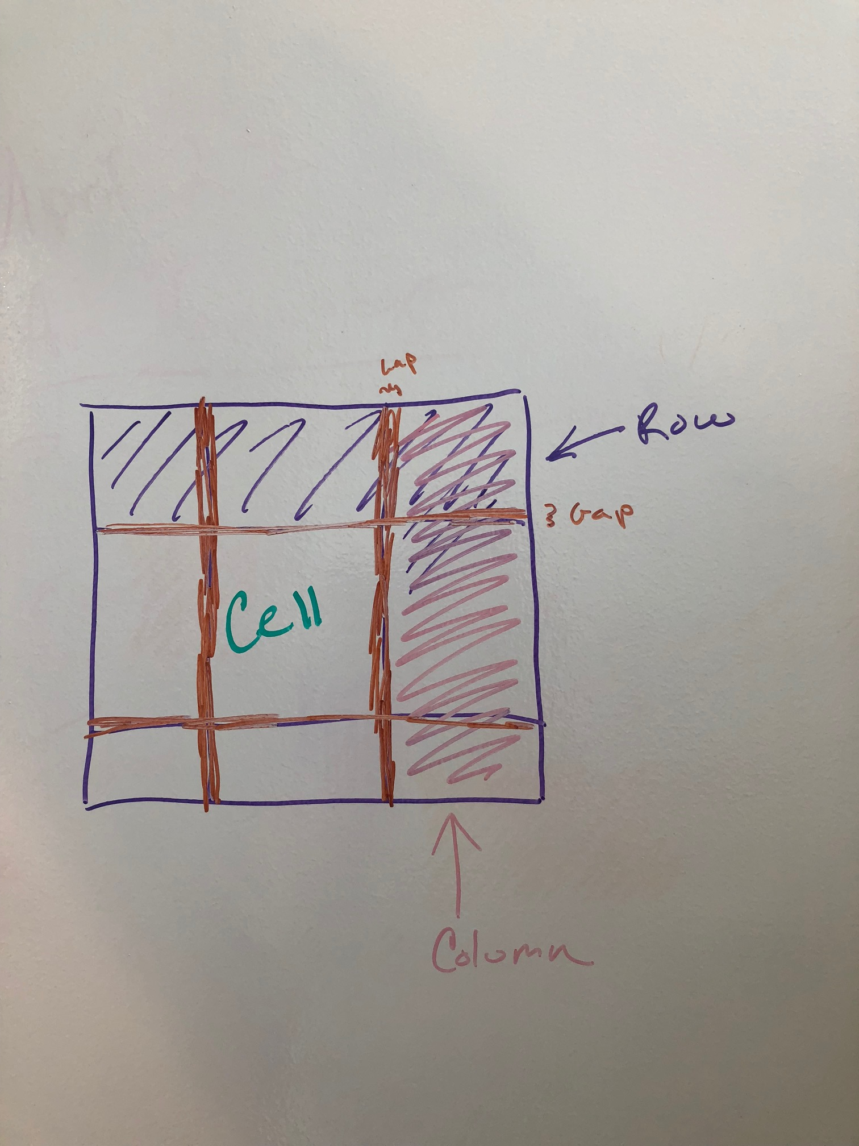
Digging into the specification
1 2 3 4
1
2
3
4
Terminology
Tracks – made up of rows and columns
Gaps - The space between tracks
Cells - The space at the intersection of rows and columns
Lines – grid lines, start at index 1, used for line-based and named-line placement
Grid area – a designated region of one or more cells

Slide 11
CodePens
Part I https://codepen.io/ccania/pen/PdqPym
Part II https://codepen.io/ccania/pen/vzOyXz
Part III https://codepen.io/ccania/pen/GXZVMp
Part IV https://codepen.io/ccania/pen/BOzEaB

Slide 12
Learning Resources
Rachel Andrew videos: Grid by Example
Grid layout patterns https://gridbyexample.com/patterns/
Jen Simmons, Learn CSS Grid http://jensimmons.com/post/feb-27-2017/learn-css-grid
MDN CSS Grid Layout https://developer.mozilla.org/en-US/docs/Web/CSS/CSS_Grid_Layout
Alignment with Grid and Flexbox cheatsheet https://rachelandrew.co.uk/css/cheatsheets/box-alignment
https://learncssgrid.com/
https://css-tricks.com/snippets/css/complete-guide-grid/
https://scrimba.com/g/gR8PTE

